Slide 1
ForeCast
FINAL PRESENTATION | Art and Machine Learning
Joong Ho Choi, Aditti Ramsisaria, Zun Wang, Kyle Yang

Slide 2
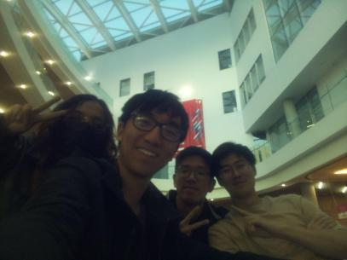
Concept & Approach
Climate change is one of the most pressing issues facing the world today
Neural style transfer to generate images of natural disaster that reflect the predicted impacts of climate change
Approach was to try working with things we haven’t worked with before

Slide 3
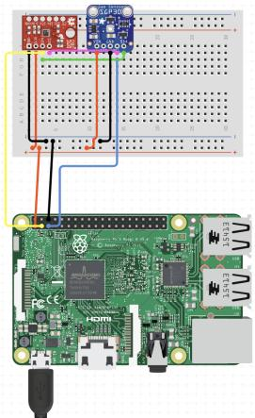

Hardware
Raspberry Pi 4 Model B
BME280
Temperature (C)
Pressure (hPa)
Altitude
Humidity (%)
ENS160
eCO2 (ppm)
TVOC (ppb)
AQI
rip arducam

Slide 4
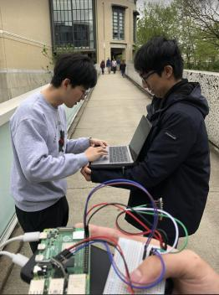
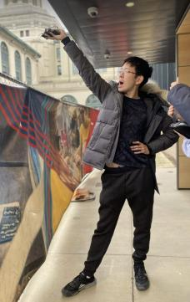

Dataset Generation
YAS QUEEN
crispy nom nom
Coding monkey university

Slide 5
Feature Vector Generation
Using all channels except altitude
Data normalization
Sampling at 5 Hz
For data over 1 second (5 samples):
Min
Max
RMS
Average
Standard Deviation
30 x 1 feature vector

Slide 6
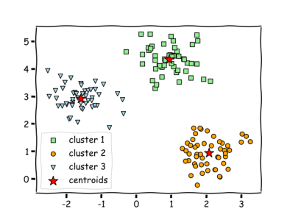
Classification
Supervised:
Random Forest
Non-ideal performance
SVM
Non-ideal performance
Unsupervised:
KNN Clustering
~0.85 prediction accuracy
Supervised classifiers were trained on smaller datasets
Dataset initially contained more of one label than others
< 0.75 prediction accuracy
Notes:
Supervised classifiers were trained on smaller datasets to reduce training time
Dataset initially contained more of one label than others so it was likely overfitting for one label
Both of these likely led to supervised methods to yield non-ideal performance

Slide 7
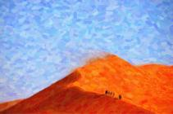
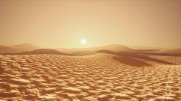

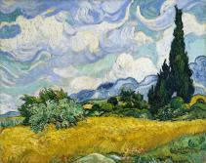
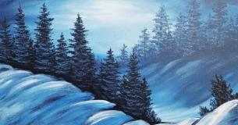
Image Generation Pt.1 (Style)
Dry
Dry 1
Ambient
Ambient 1
Cold

Slide 8
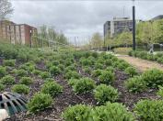
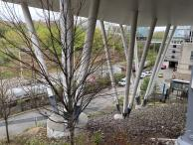
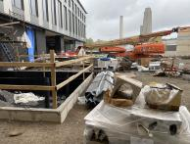
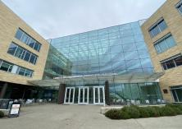
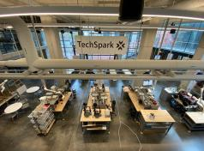
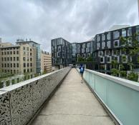
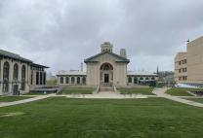
Image Generation Pt.2 (Content)

Slide 9
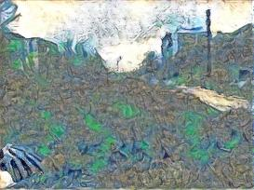
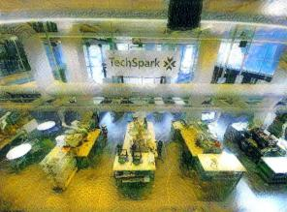
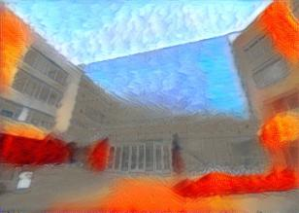
Filtering/Weeding out the worst 3

Slide 10
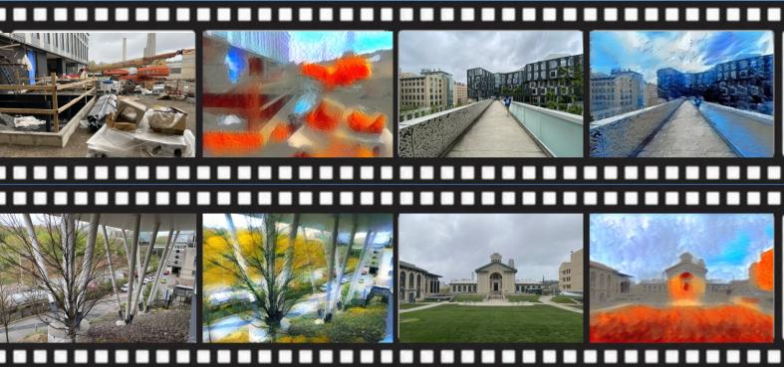
Results

Slide 11
More Results

